Slide 1
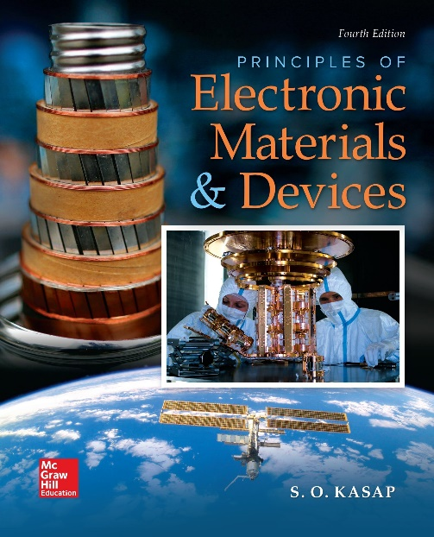
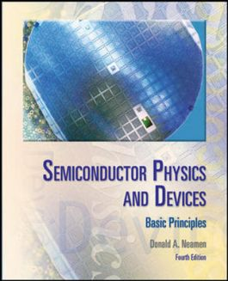

ELECTRONIC MATERIALS AND DEVICES
L | T | P | J | C
3 | 0 | 0 | 0 | 3
Dr. M. Saranya Nair
School of Electronics Engineering
VIT-Chennai Campus
E-mail : saranyanair.m@vit.ac.in
MODULE 4

Slide 2
ELECTRONIC MATERIALS AND DEVICES
MODULE 4
Junction diodes

Slide 3
PN JUNCTION
Upto this point, we have been considering the properties of the semiconductor material.
We calculated electron and hole concentrations in thermal equilibrium and determined the position of the Fermi level.
We then considered the non-equilibrium condition in which excess electrons and holes are present in the semiconductor.
We now wish to consider the situation in which a p-type and an n-type semiconductor are brought into contact with one another to form a pn junction.
Most semiconductor devices contain at least one junction between p-type and n-type semiconductor regions.
Semiconductor device characteristics and operation are intimately connected to these pn junctions

Slide 4
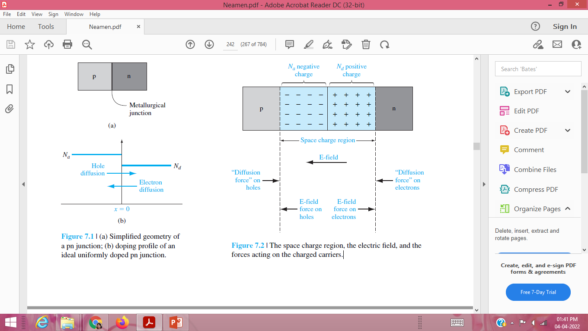
BASIC STRUCTURE OF THE pn JUNCTION
The entire semiconductor is a single-crystal material in which one region is doped with acceptor impurity atoms to form the p region and the adjacent region is doped with donor atoms to form the n region. The interface separating the n and p regions is referred to as the metallurgical junction.
A step junction is considered which indicates the doping concentration is uniform in each region and there is an abrupt change in doping at the junction.
Initially, at the metallurgical junction, there is a very large density gradient in both electron and hole concentrations.

Slide 5
Majority carrier electrons in the n region will begin diffusing into the p region, and majority carrier holes in the p region will begin diffusing into the n region.
This diffusion process cannot continue indefinitely. As electrons diffuse from the n region, positively charged donor atoms are left behind. Similarly, as holes diffuse from the p region, they uncover negatively charged acceptor atoms.
The net positive and negative charges in the n and p regions induce an electric field in the region near the metallurgical junction, in the direction from the positive to the negative charge, or from the n to the p region.
Density gradients still exist, producing a “diffusion force” that acts on the majority carriers. The electric field in the space charge region produces another force on the electrons and holes, which is in the opposite direction to the diffusion force for each type of particle. In thermal equilibrium, the diffusion force and the E-field force exactly balance each other.

Slide 6
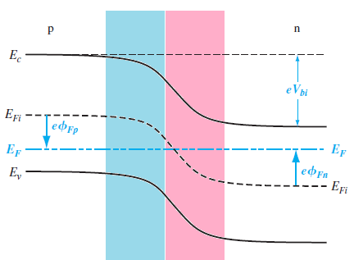
ZERO APPLIED BIAS
If we assume that no voltage is applied across the pn junction, then the junction is in thermal equilibrium—the Fermi energy level is constant throughout the entire system.
Electrons in the conduction band of the n region see a potential barrier in trying to move into the conduction band of the p region.
This potential barrier is referred to as the built-in potential barrier and is denoted by Vbi.
This potential difference across the junction cannot be measured with a voltmeter because new potential barriers will be formed between the probes and the semiconductor

Slide 7
We may derive another form of the equations for the thermal-equilibrium concentrations of electrons and holes. If we add and subtract an intrinsic Fermi energy

Slide 9
Calculate the built-in potential barrier in a pn junction. Consider a silicon pn junction at T = 300 K with doping concentrations of Na = 2 x 10¹⁷ /cm³ and Nd = 10¹⁵ /cm³. (Ans:0.713)

Slide 10
We will assume that the space charge region abruptly ends in the n region at x = xn and abruptly ends in the p region at x = -xp
The electric field is determined from Poisson’s equation,
The constant of integration is determined by setting E = 0 at x = -xp. The electric field in the p region is then given by
The constant of integration is determined by setting E = 0 at x = -xp.

Slide 11
The electric field is also continuous at the metallurgical junction, or at x = 0. Setting
Electric field Equations equal to each other at x = 0 gives
set the potential equal to zero at x = -xp .

Slide 12
Space Charge Width

Slide 13
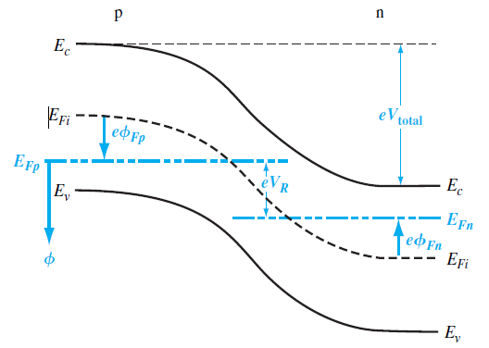
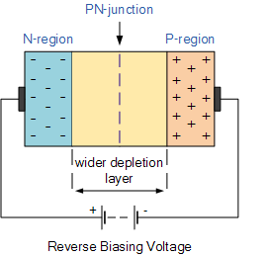
REVERSE APPLIED BIAS
If we apply a potential between the p and n regions, we will no longer be in an equilibrium condition—the Fermi energy level will no longer be constant through the system.
The total potential barrier, indicated by Vtotal , has increased. The applied potential is the reverse-biased condition. The total potential barrier is now given by

Slide 14
Space Charge Width and Electric Field
In all of the previous equations, the built-in potential barrier can be replaced by the total potential barrier. The total space charge width can be written

Slide 15
Calculate the width of the space charge region in a pn junction when a reverse biased
voltage is applied.
Consider a silicon pn junction at T = 300 K with doping concentrations of Na=10¹⁶/cm³ and Nd =10¹⁵ /cm³. Assume that ni = 1.5x10¹⁰/cm³ and VR = 5 V.

Slide 16
Design a pn junction to meet maximum electric field and voltage specifications.
Consider a silicon pn junction at T = 300 K with a p-type doping concentration of Na = 2 x 10¹⁷ /cm³. Determine the n-type doping concentration such that the maximum electric field is Emax = 2.5 x 10⁵ V/cm at a reverse-biased voltage of VR = 25 V.

Slide 17
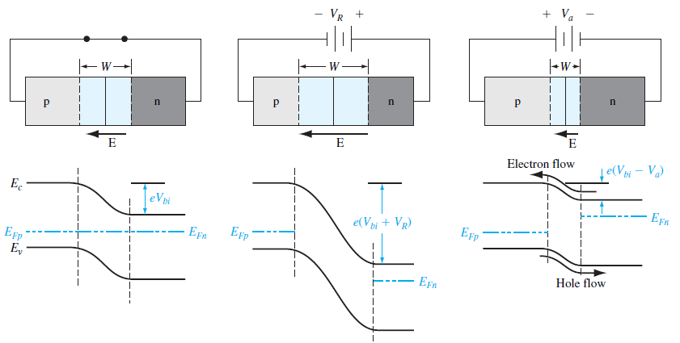
FORWARD APPLIED BIAS
When a forward-bias voltage is applied to a pn junction, a current will be induced in the device.

Slide 18
FORWARD APPLIED BIAS
The total potential barrier is now reduced.
The smaller potential barrier means that the electric field in the depletion region is also reduced.
The smaller electric field means that the electrons and holes are no longer held back in the n and p regions, respectively.
There will be a diffusion of holes from the p region across the space charge region where they will flow into the n region. Similarly, there will be a diffusion of electrons from the n region across the space charge region where they will flow into the p region.
The flow of charge generates a current through the pn junction.

Slide 19
Ideal Current–Voltage Relationship

Slide 20
Ideal Current–Voltage Relationship
If we divide the equation by Vt = kT / e, take the exponential of both sides, and
then take the reciprocal

Slide 21
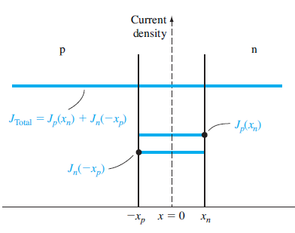
Ideal pn Junction Current

Slide 22
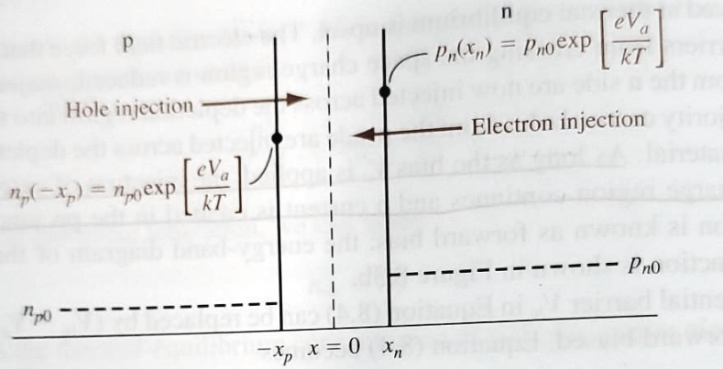

Slide 24
Determine the ideal reverse-saturation current density in a silicon pn junction at T = 300 K. Consider the following parameters in a silicon pn junction:

Slide 25

Calculate the minority carrier concentrations at the edge of the space charge regions in a forward-biased pn junction.
Consider a silicon pn junction at T = 300 K. Assume the doping concentration in the n region is Nd = 10¹⁶ cm³ and the doping concentration in the p region is Na = 6 x 10¹⁵ cm³, and assume that a forward bias of 0.60 V is applied to the pn junction.

Slide 26
Design a pn junction diode to produce particular electron and hole current densities at a given forward-bias voltage.
Consider a silicon pn junction diode at T = 300 K. Design the diode such that Jn = 20 A /cm2 and Jp = 5 A /cm2 at Va = 0.65 V. Assume the remaining semiconductor parameters are as given in previous problem.

Slide 27
Junction Capacitance
Since we have a separation of positive and negative charges in the depletion region, a capacitance is associated with the pn junction. Figure shows the charge densities in the depletion region for applied reverse-biased voltages of VR and VR + dVR.
An increase in the reverse-biased voltage will uncover additional positive charges in the n region and additional negative charges in the p region.
The junction capacitance is defined as
The differential charge dQ is in units of C/cm² so that the capacitance C is in units of farads per square centimeter F/cm²), or capacitance per unit area.

Slide 28
Exactly the same capacitance expression is obtained by considering the space charge region extending into the p region xp. The junction capacitance is also referred to as the depletion layer capacitance.

Slide 29
Consider a silicon pn junction at T = 300 K with doping concentrations of Na=10¹⁶/cm³ and Nd =10¹⁵ /cm³. Assume that ni = 1.5x10¹⁰/cm³ and VR = 5 V.
Calculate the junction capacitance of a pn junction.

Slide 30
One-Sided Junctions
Consider a special pn junction called the one-sided junction. If, for example, Na >> Nd, this junction is referred to as a p⁺n junction. The total space charge width, reduces to
Considering the expressions for xn and xp, we have for the p⁺n junction
xp << xn. Almost the entire space charge layer extends into the low-doped region of the junction.

Slide 31
An ideal one-sided silicon p⁺n junction at T = 300 K is uniformly doped on both sides of the metallurgical junction. It is found that the doping relation is N_{a} = 80 N_{d} and the built-in potential barrier is V_{bi} = 0.740 V. A reverse-biased voltage of V_{R} = 10 V is applied. Determine (a) N_{a}, N_{d}; (b) x_{p}, x_{n}; (c) |E_{max}|; and (d) Cj. Repeat the same problem for zero bias condition.

Slide 32
JUNCTION BREAKDOWN
The reverse-biased voltage should not increase without limit; at some particular voltage, the reverse-biased current will increase rapidly. The applied voltage at this point is called the breakdown voltage.
Two physical mechanisms give rise to the reverse-biased breakdown in a pn junction: the Zener effect and the avalanche effect.

Slide 33
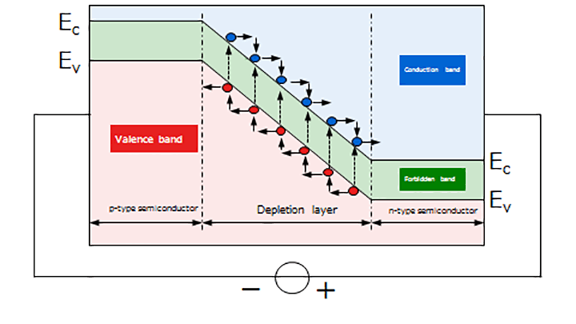
When a pn junction is reverse-biased, a small quantity of electrons passes through the pn junction. These electrons are accelerated in the depletion layer by an electric field, acquiring large kinetic energy. The accelerated electrons collide with the atoms in a crystal lattice, ionizing them and creating electron holes. The electrons of these atoms are excited to the conduction band and knocked out, becoming free electrons. The free electrons are also accelerated and collide with other atoms, creating more electron-hole pairs and leading to further knocking-out processes. This phenomenon is called avalanche breakdown.

Slide 34
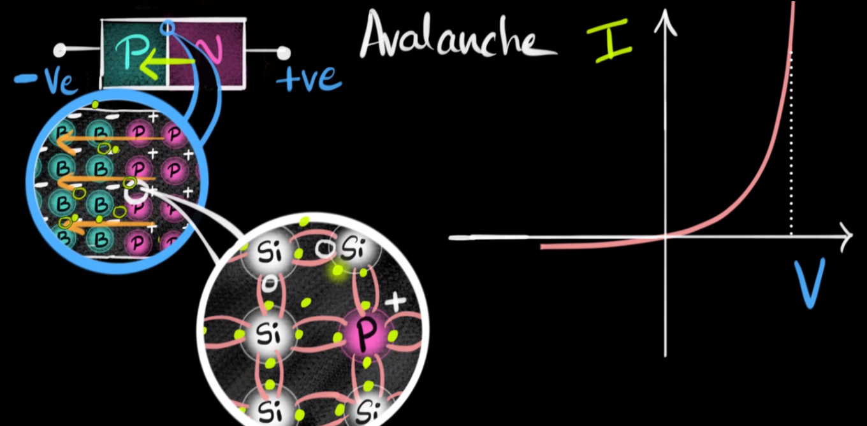

Slide 35
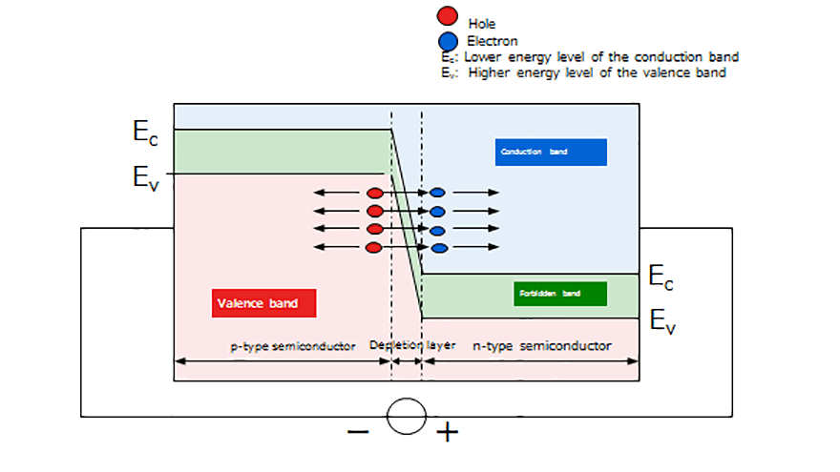
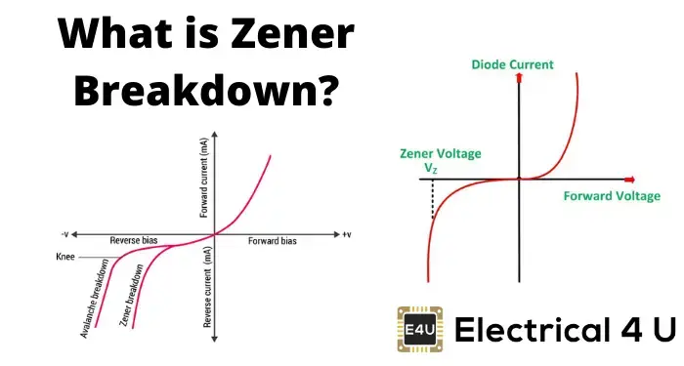
Zener breakdown occurs in highly doped pn junctions through a tunneling mechanism. In a highly doped junction, the conduction and valence bands on opposite sides of the junction are sufficiently close during reverse bias that electrons may tunnel directly from the valence band on the p side into the conduction band on the n side.

